Slide 1



NGO Supported: Akshaya Patra
Challenge Statement: To develop a web based “RECIPE SIMULATOR” that can generate the best recipe taking into account the combination of available ingredients, their nutritional values and cost.

Slide 2
What our simulator is capable of..
Initially the log in page is displayed on which
on which two types of people can log in-
a)The Inventory Manager
b)The Recipe Manager
The inventory manager can update the ingredients in the ingredients table.
The recipe manager selects the ingredients and the available recipes are displayed.

Slide 3
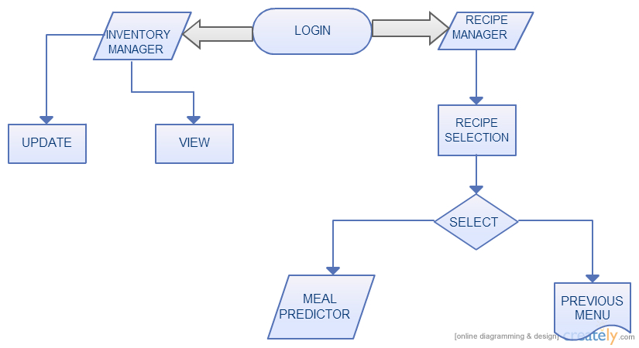
FLOWCHART

Slide 4
Future Enhancements
REGION SPECIFIC
Inventory specific
Cost specific

